Slide 1
LOG ANALYSIS WITH SPARK
By
KARTHIKEYAN K R

Slide 2
Agenda
Project Statement
Project Overview
Project Requirements
Architecture Diagram
Implementation
Conclusion
1

Slide 3
Project Statement
Utilize Azure Data Factory to ingest log data into Azure Storage, and leverage Azure Databricks for log analysis using Apache Spark for insights such as error rates, trends, and anomalies
2

Slide 4
Project Overview
This project aims to provide a data analysis solution for Log files using Azure Databricks.
Once the data is stored in Azure Storage, the project aims to leverage Azure Databricks, a cloud-based analytics platform, to perform log analysis using Apache Spark.
The focus of the analysis is to extract valuable insights from the log data, such as error rates, trends, and anomalies.
3

Slide 5
Project Requirements
Azure Subscription
Data Sources
Azure Data Factory
Azure Storage
Azure Databricks
4

Slide 6
Azure Subscription
You need one Azure subscription account to perform this project.
5

Slide 7
Data Sources
I downloaded sample log file from one public repository. From that repository I took “Traffic Violation.csv” as “Traffic.csv”.
Repo Link: Click here
(https://github.com/pycaret/pycaret/blob/master/datasets/Traffic%20Violaions.csv)
6

Slide 8
Azure Data Factory
Azure Data Factory is Azure's cloud ETL service for scale-out serverless data integration and data transformation. It offers a code-free UI for intuitive authoring and single-pane-of-glass monitoring and management.
7

Slide 9
Azure Storage
The Azure Storage platform is Microsoft's cloud storage solution for modern data storage scenarios. Azure Storage offers highly available, massively scalable, durable, and secure storage for a variety of data objects in the cloud.
8

Slide 10
Azure Databricks
Azure Databricks provides the latest versions of Apache Spark and allows you to seamlessly integrate with open source libraries. Spin up clusters and build quickly in a fully managed Apache Spark environment with the global scale and availability of Azure.
Log analysis and Visualization will be done on Azure Databricks.
9

Slide 11
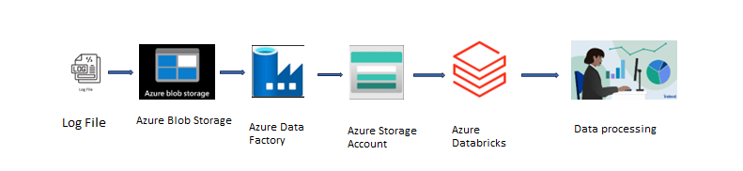
Architecture diagram
10

Slide 12
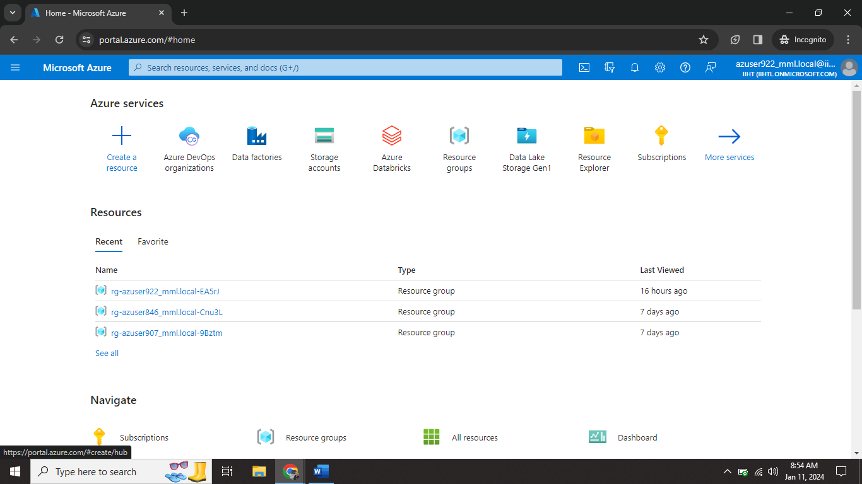
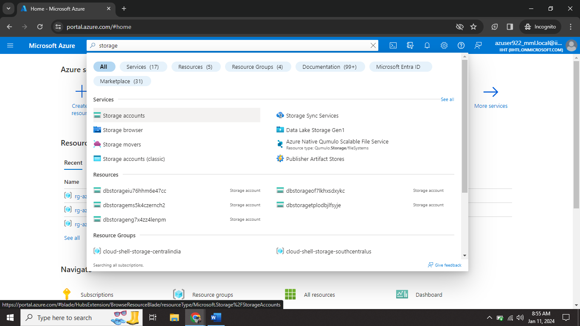
Implementation
11

Slide 13
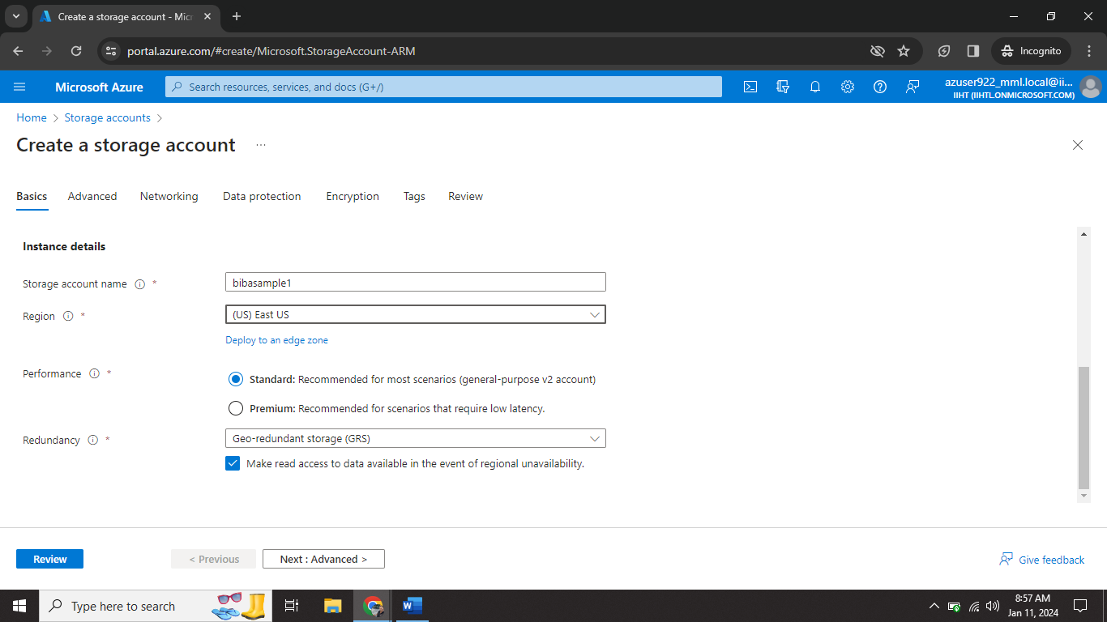
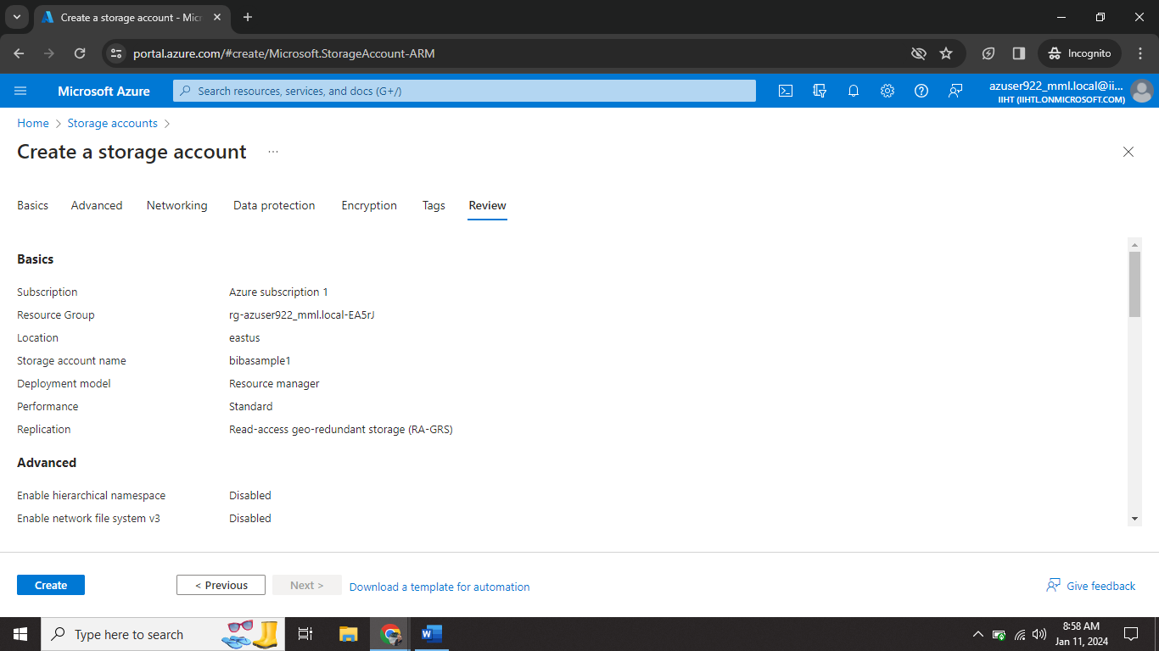
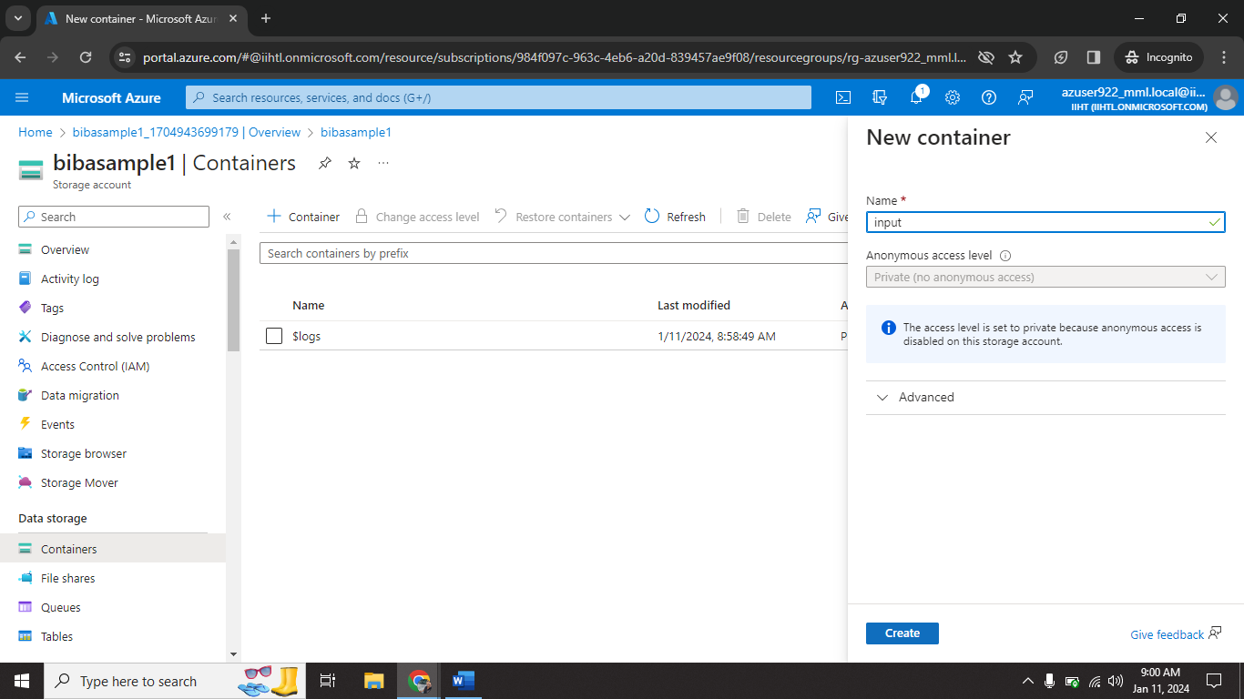
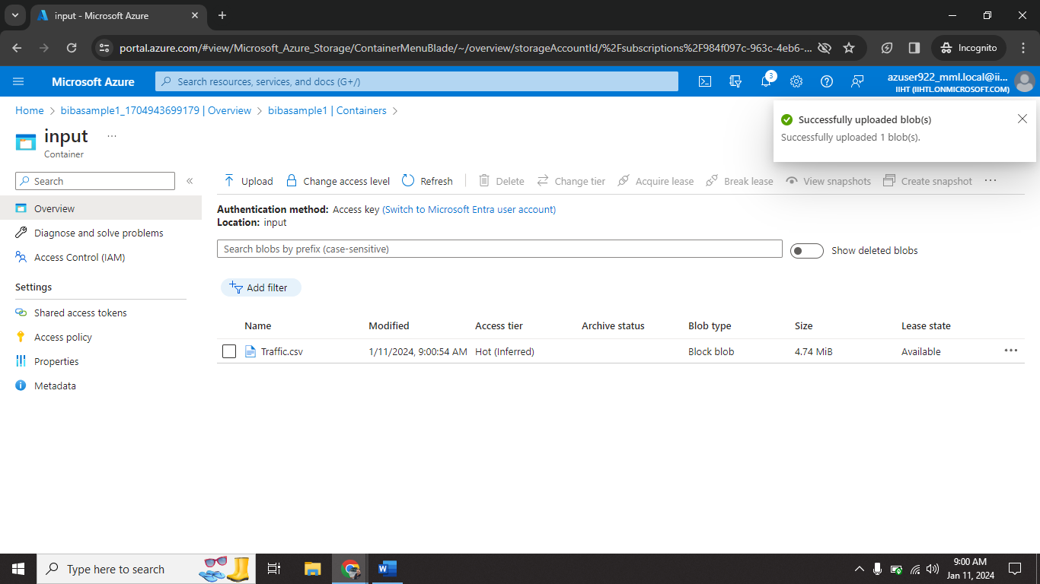
12

Slide 14

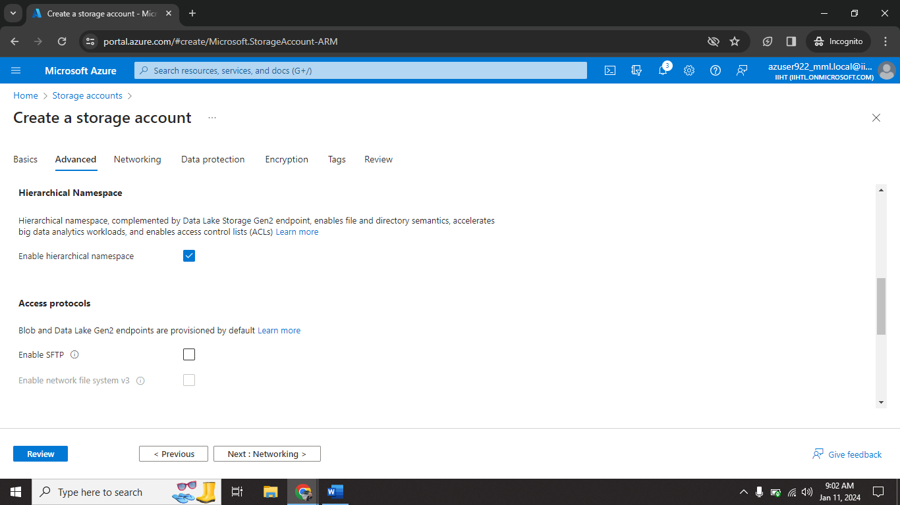
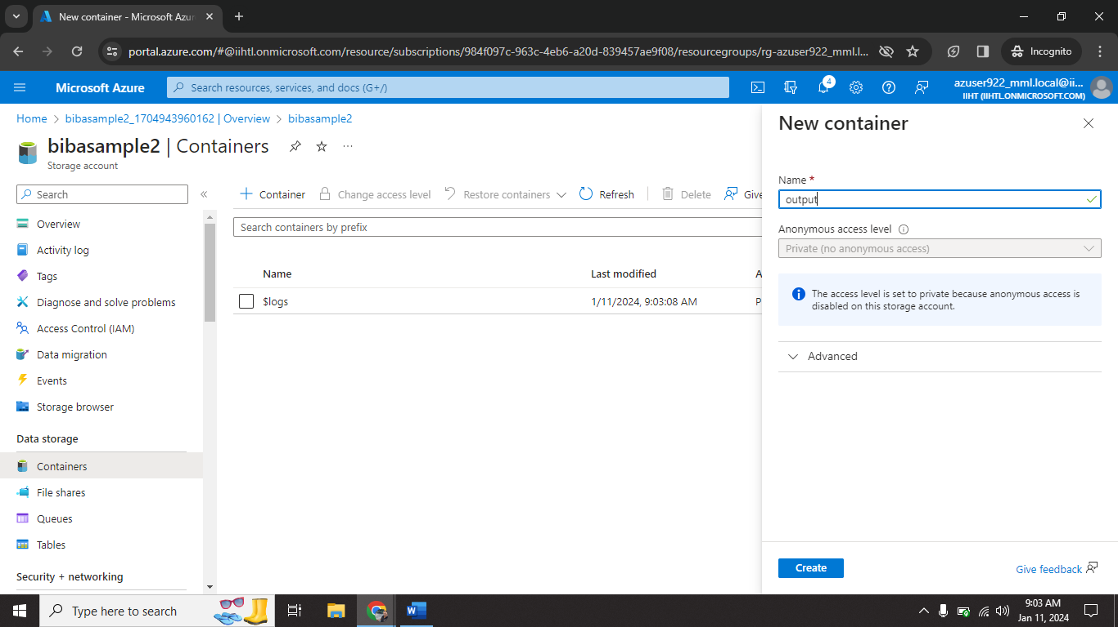
13

Slide 15
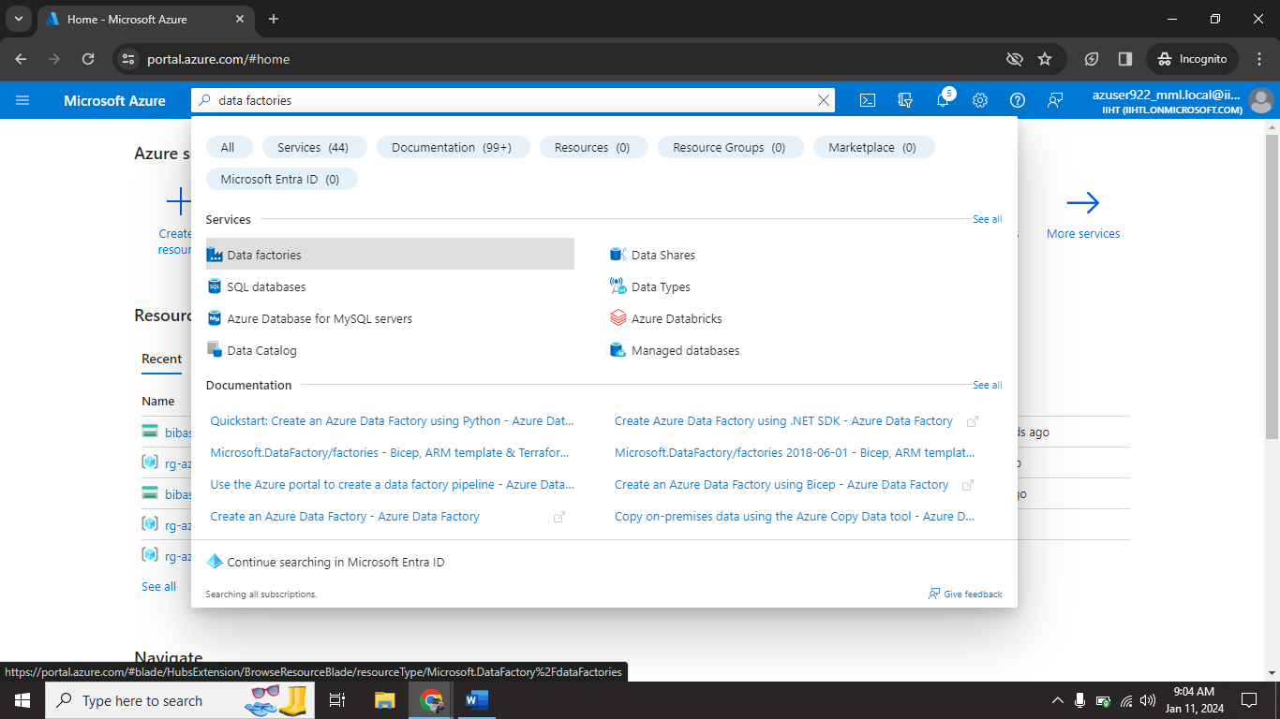
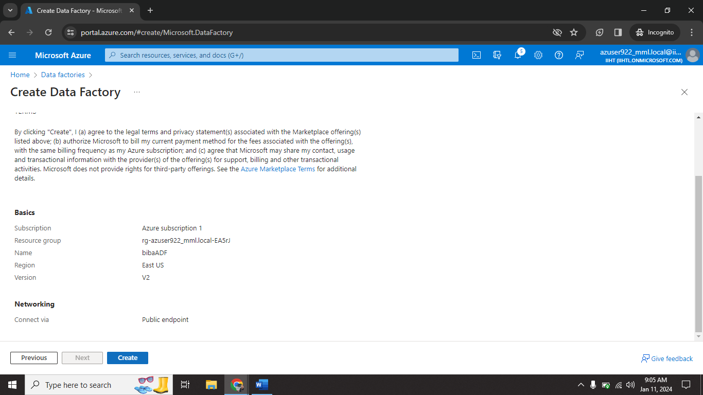
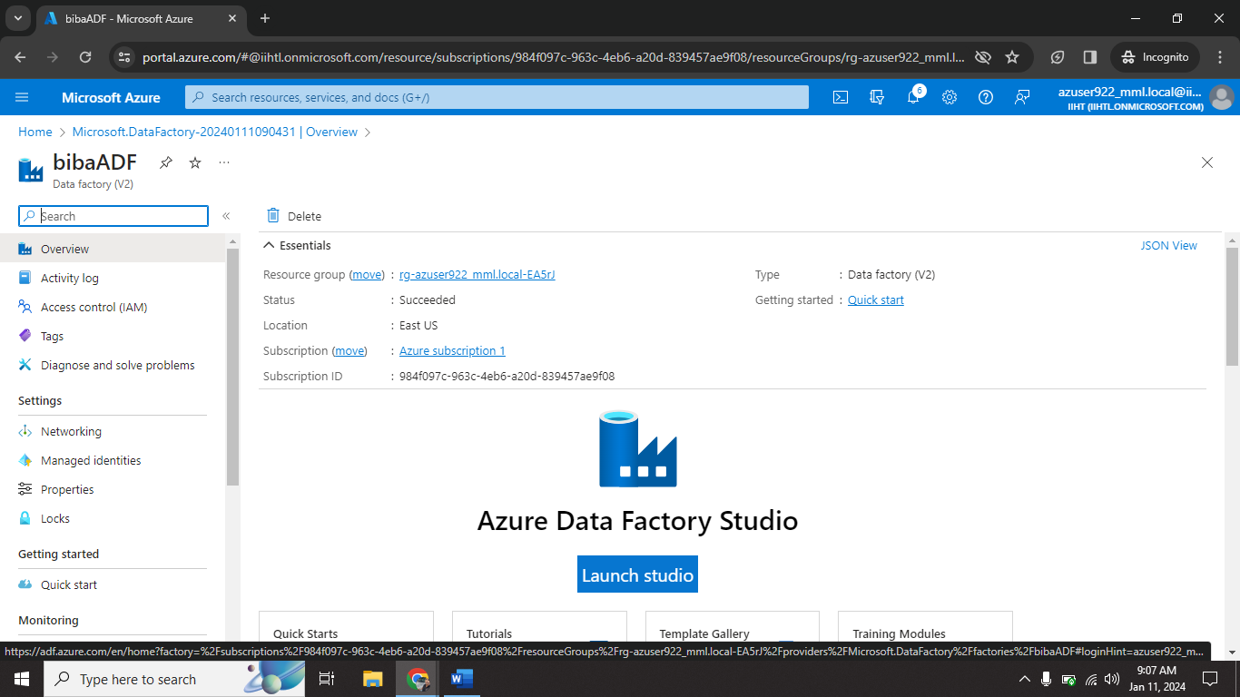
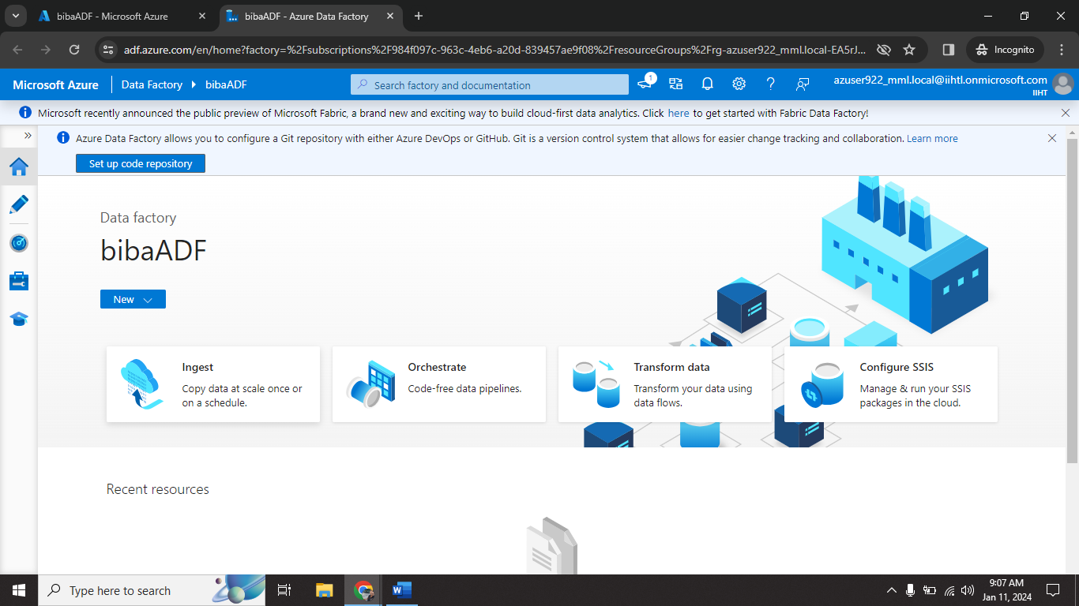
14

Slide 16
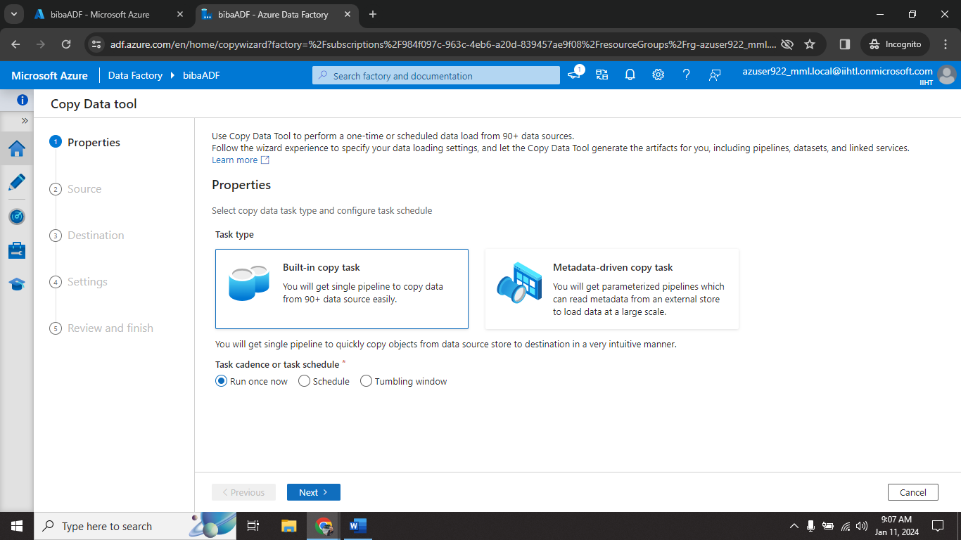
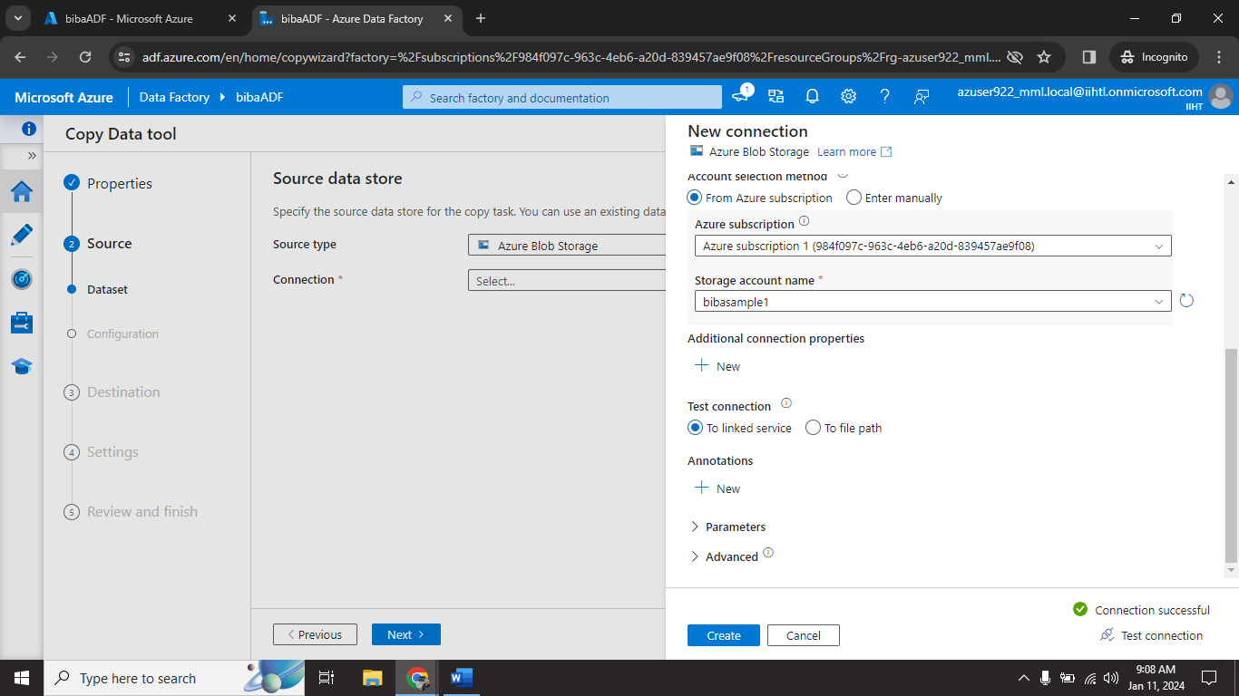
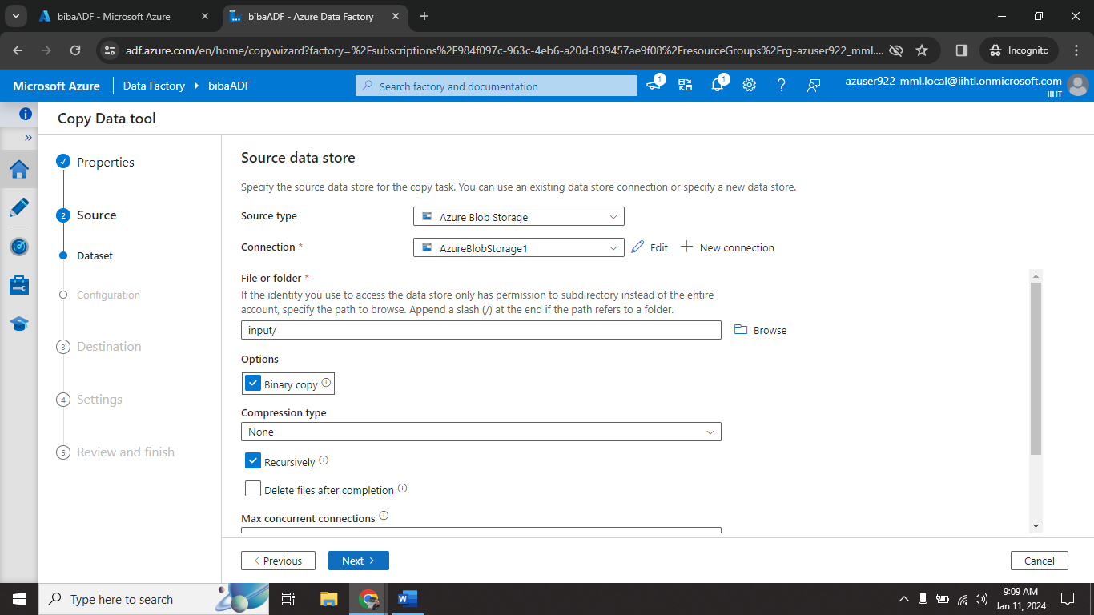
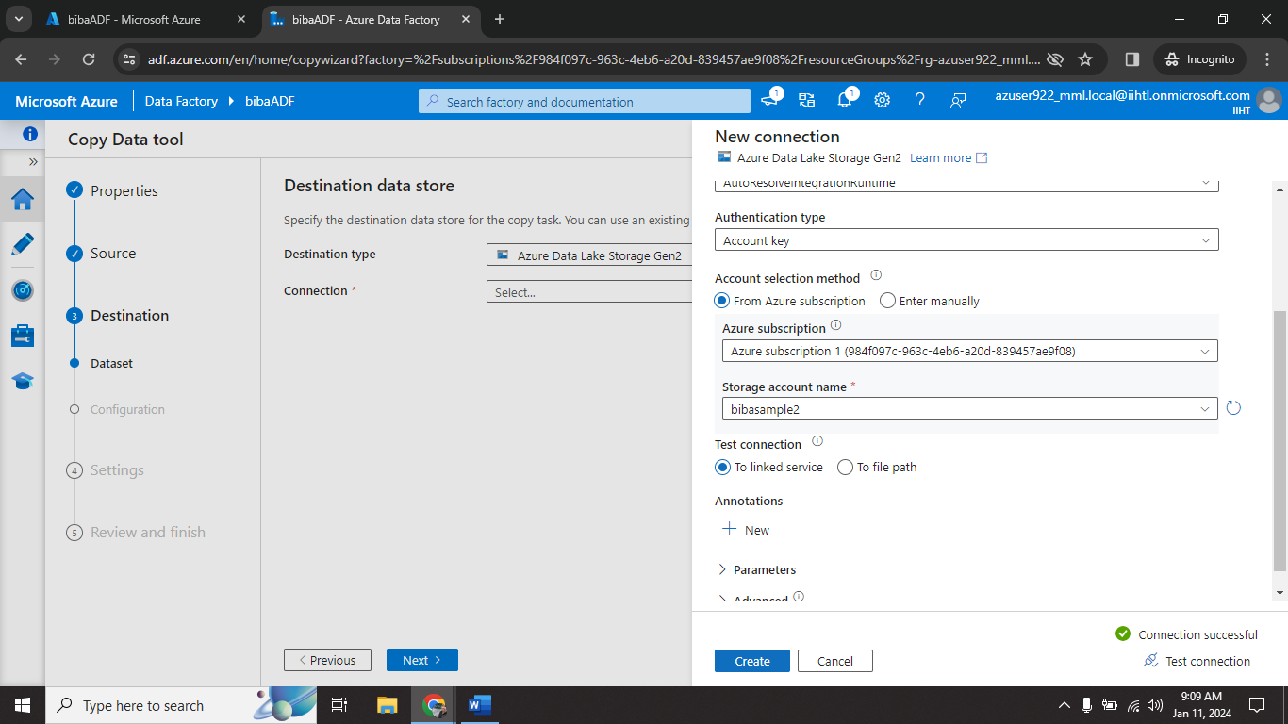
15

Slide 17

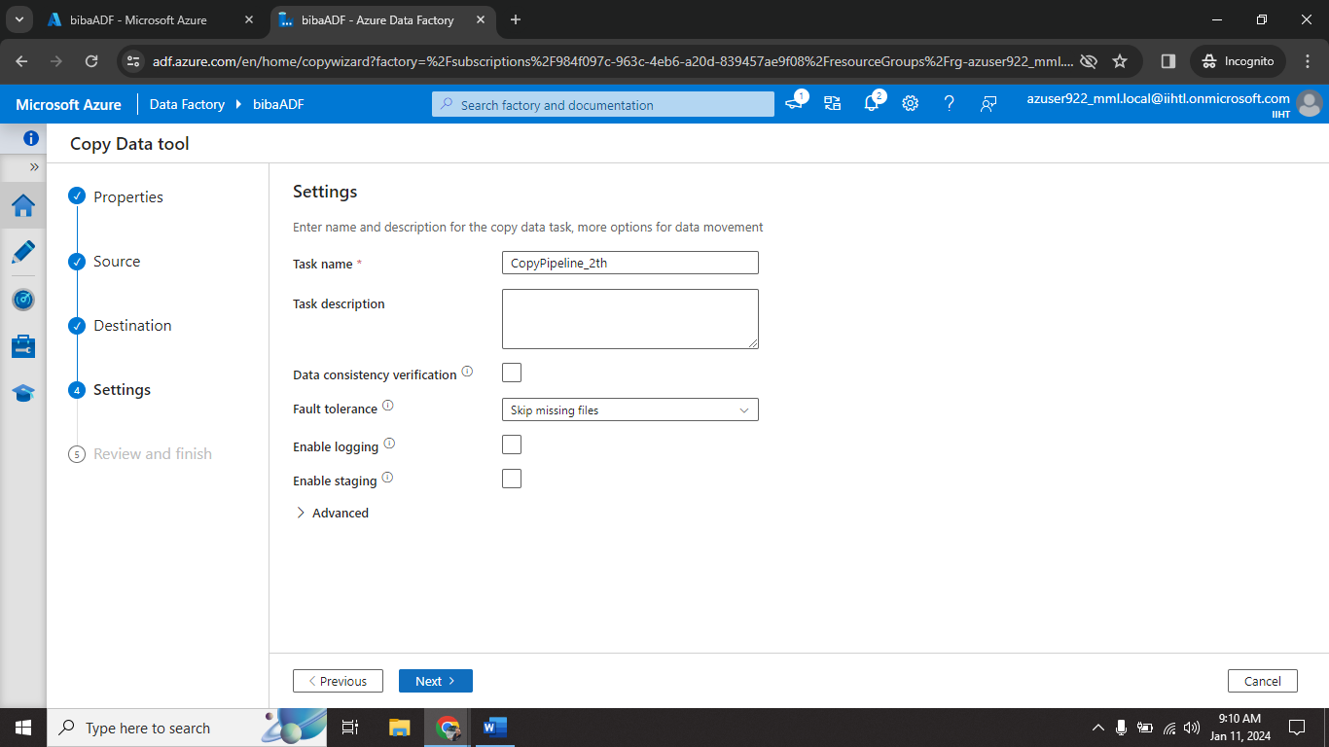
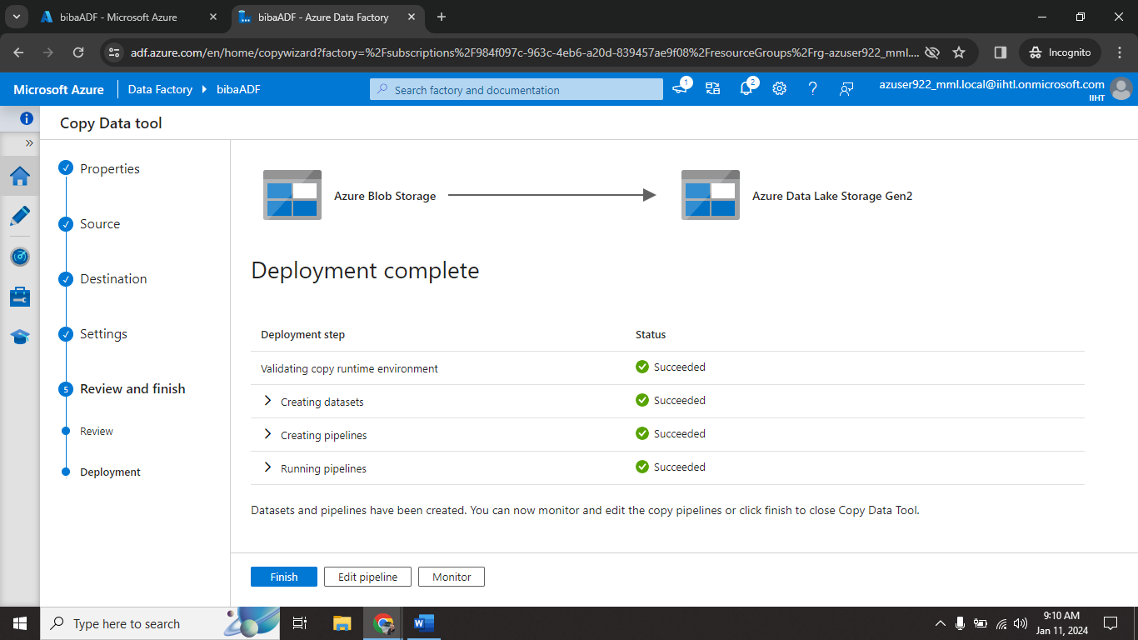
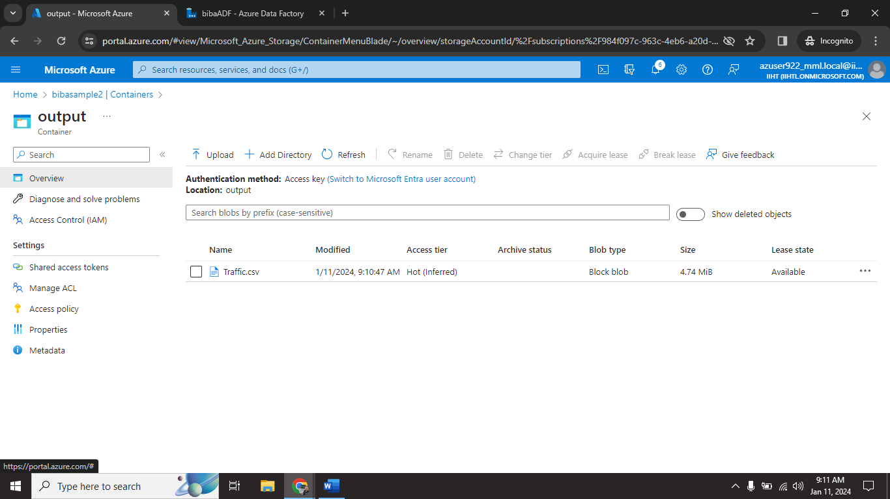
16

Slide 18
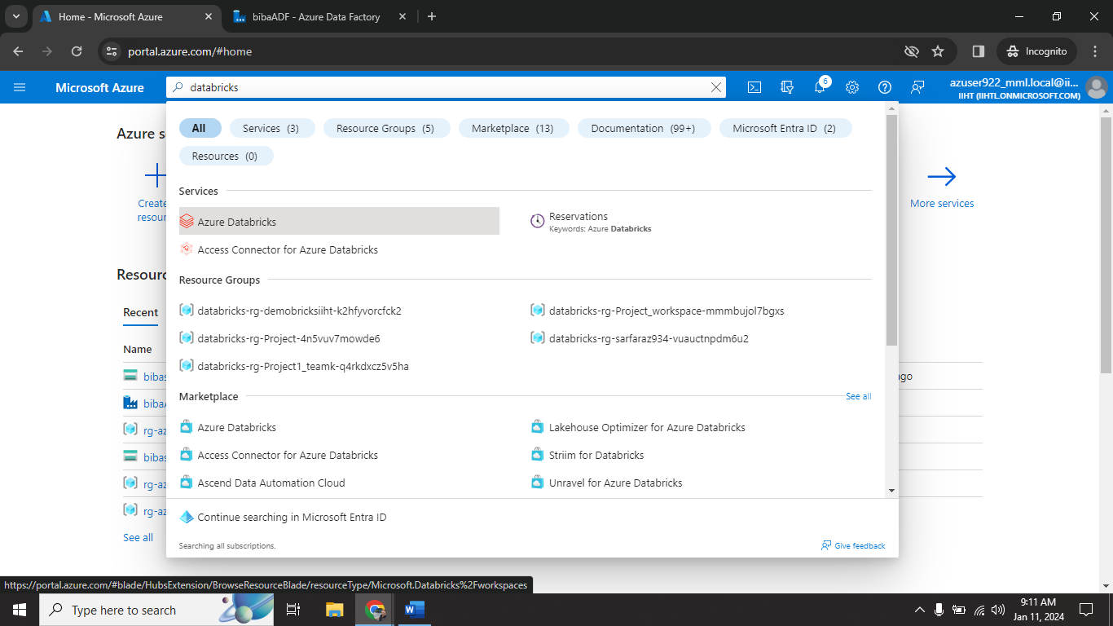
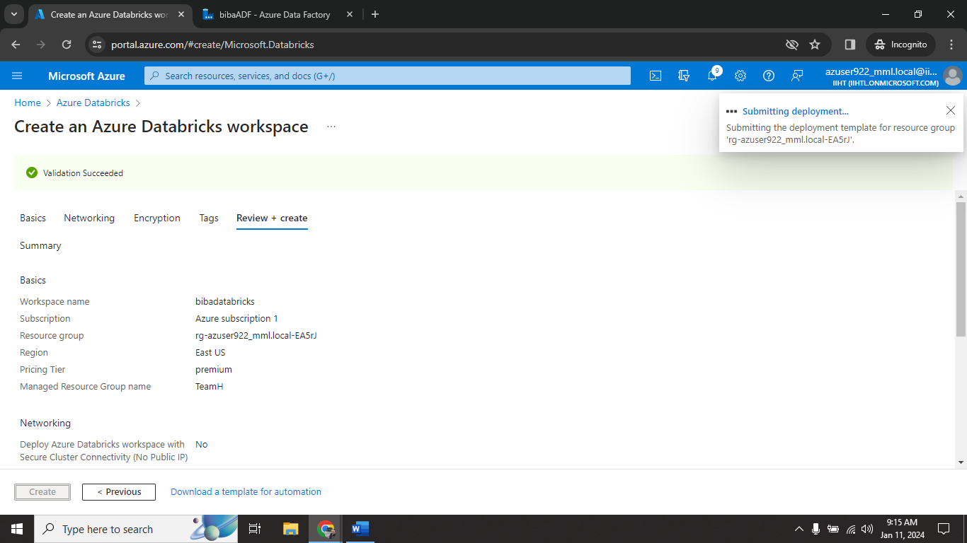
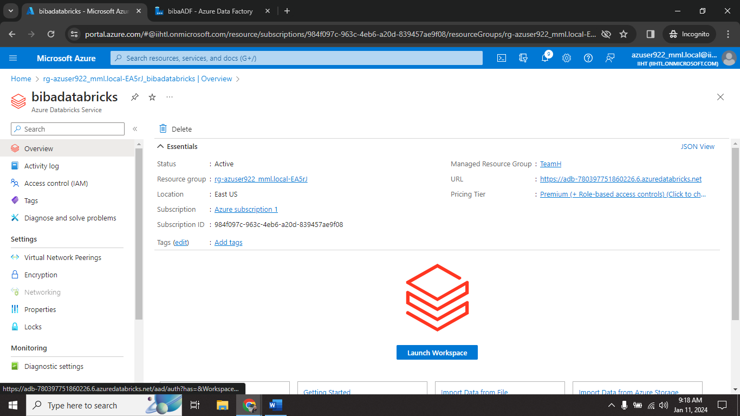
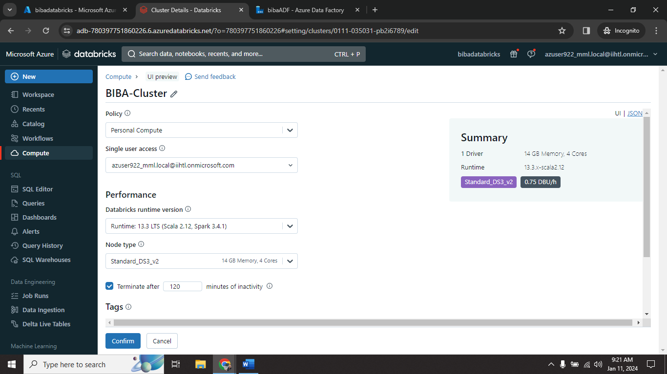
17

Slide 19
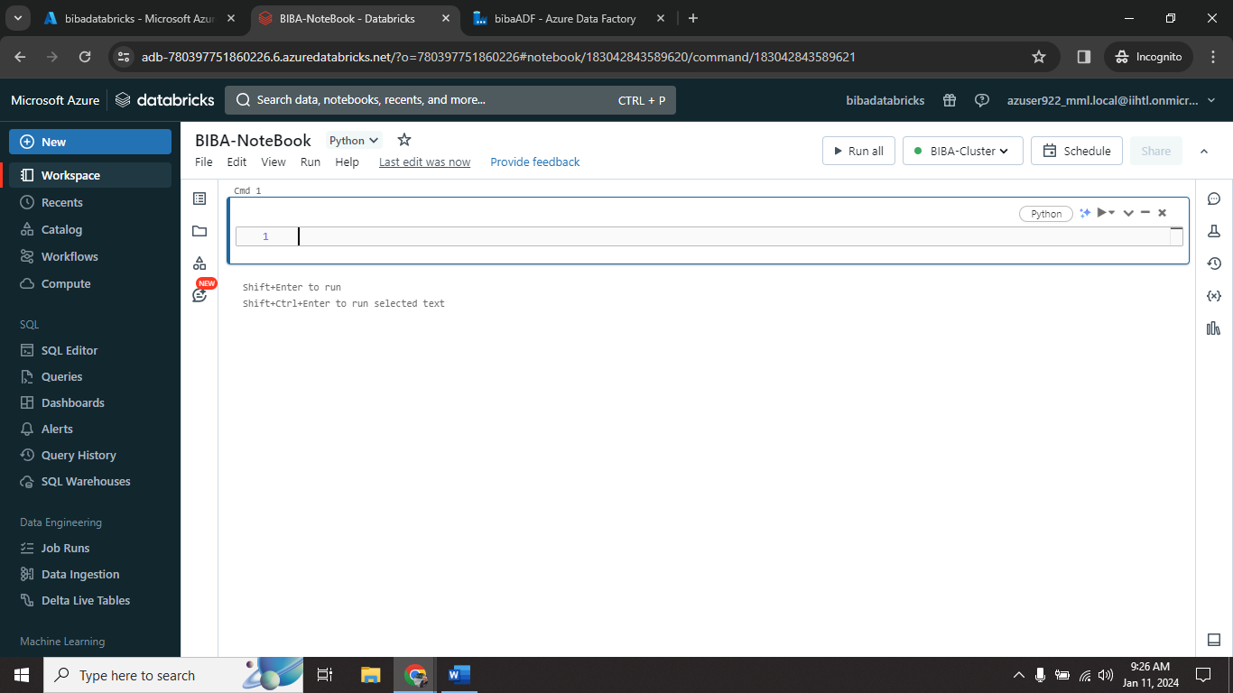
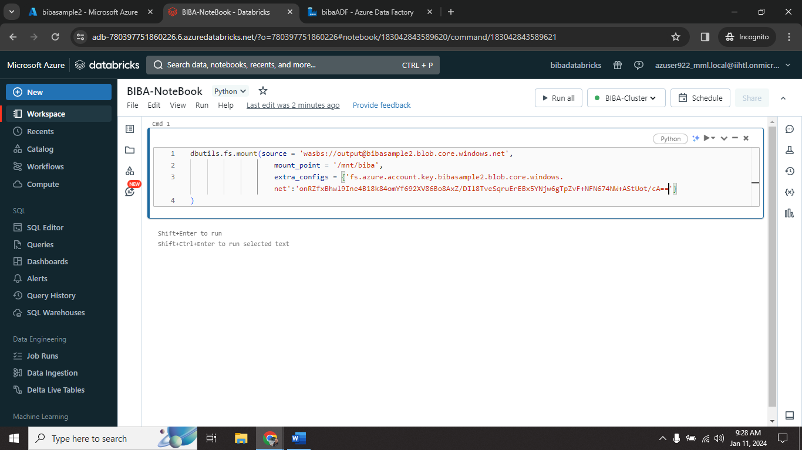
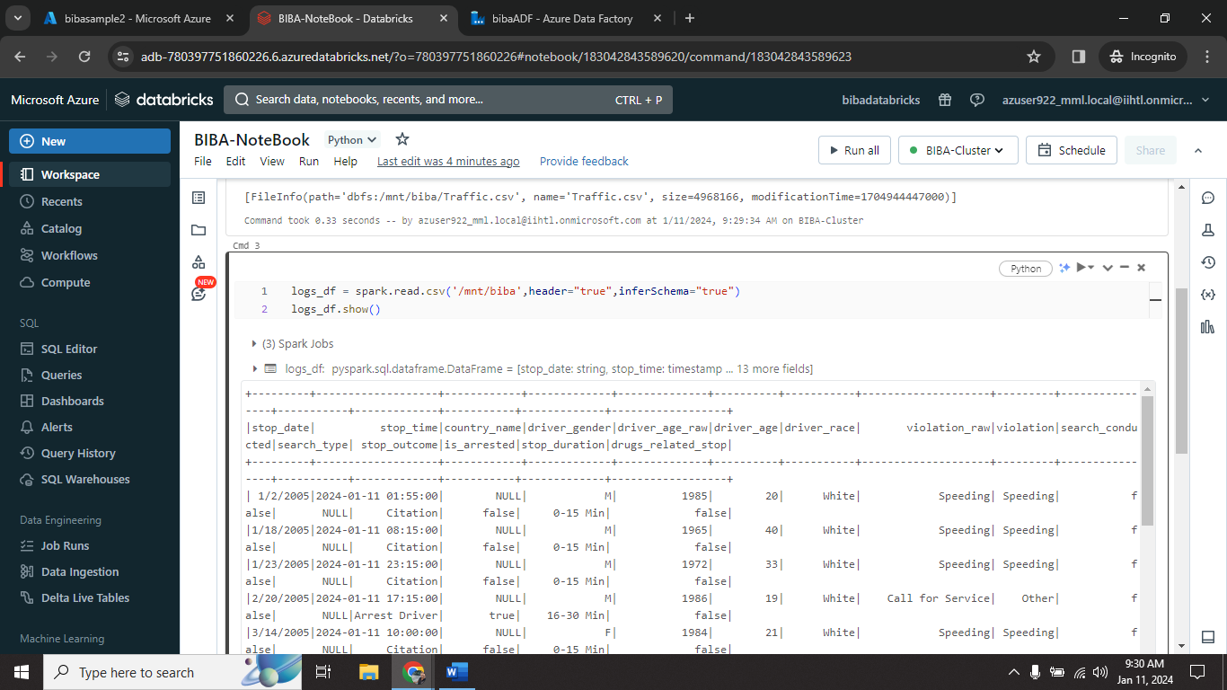
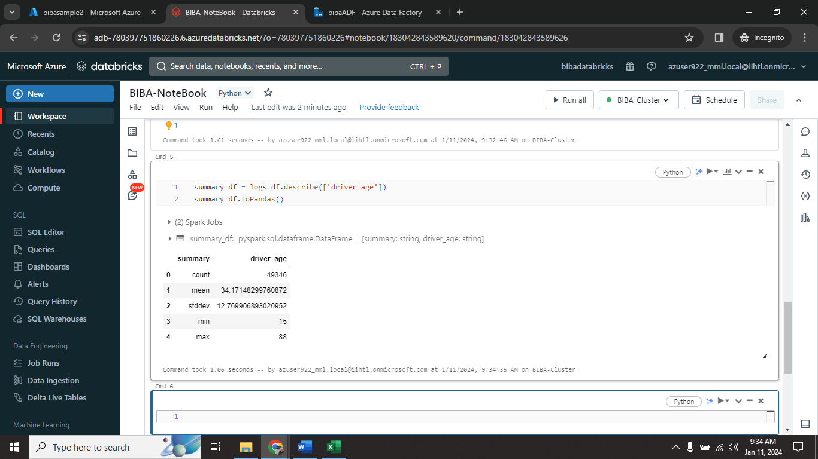
18

Slide 20
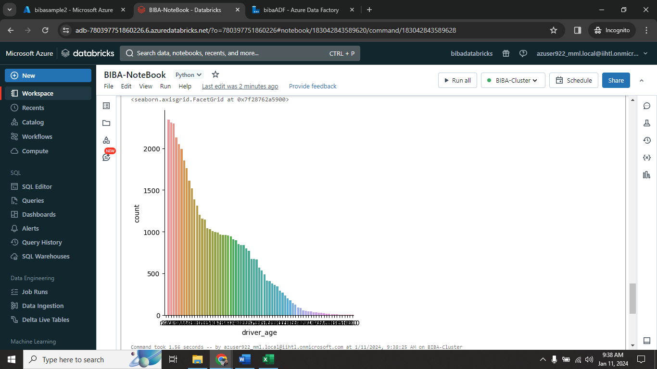
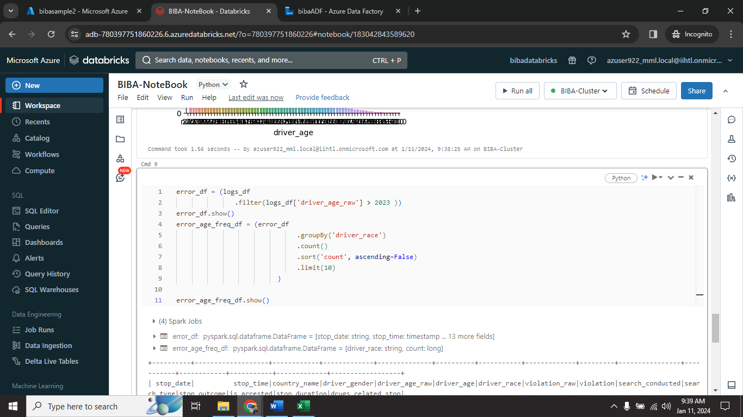
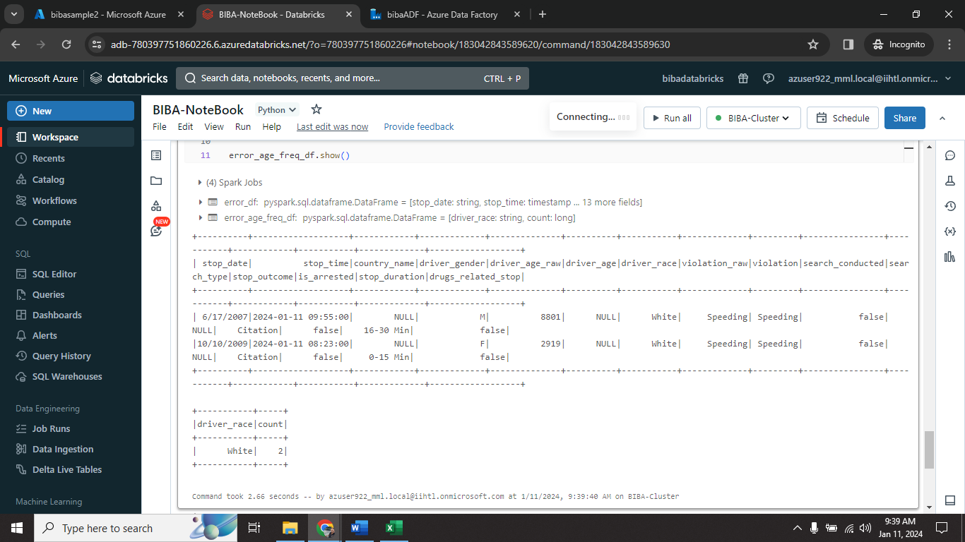
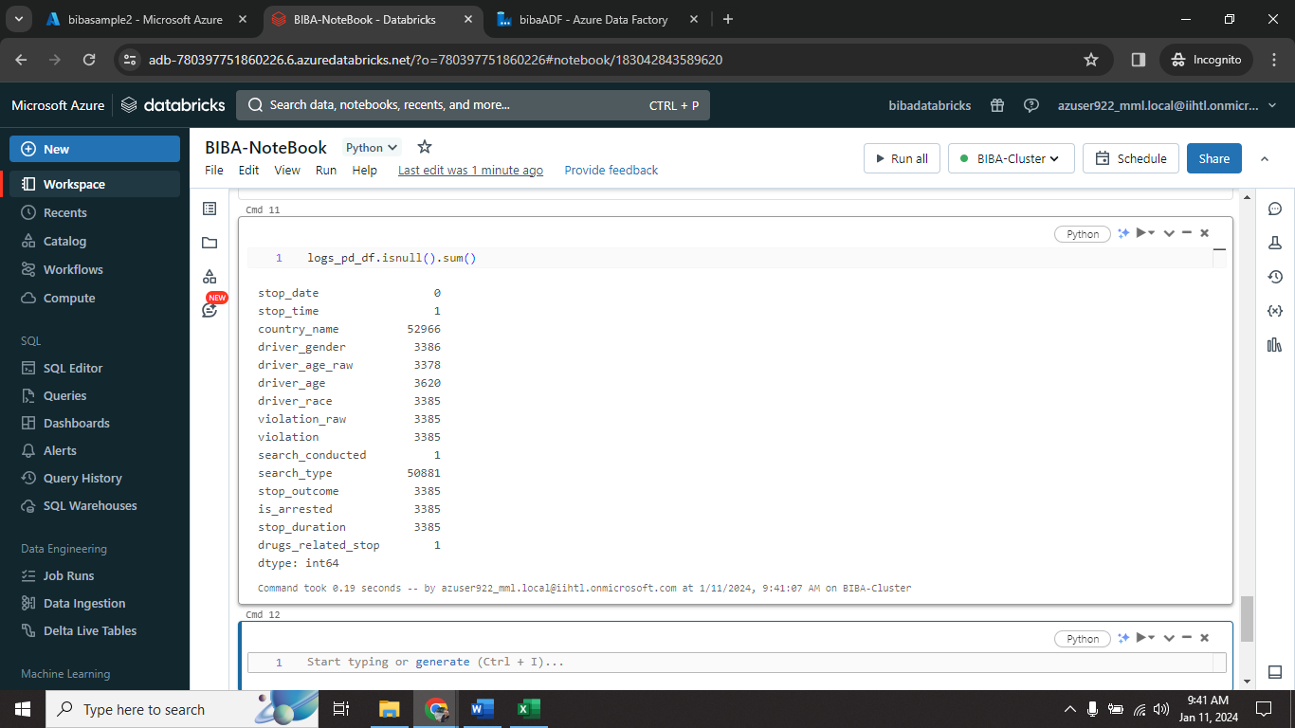
19

Slide 21

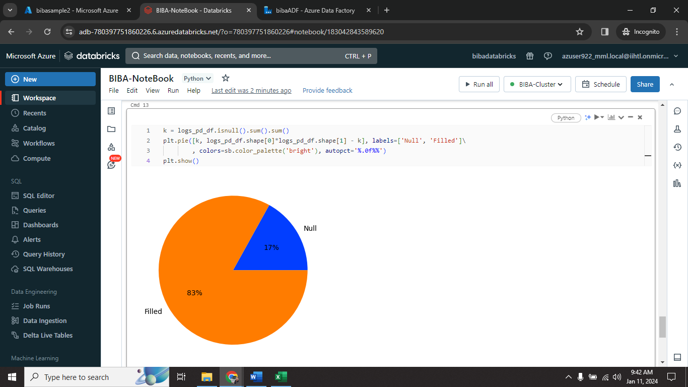
20

Slide 22
Conclusion
In conclusion, this project presents a comprehensive solution for log data management and analysis using Azure Data Factory and Azure Databricks. By leveraging these Azure services, the project aims to streamline the process of ingesting log data from diverse sources into Azure Storage and subsequently harnessing the power of Apache Spark for insightful analytics.
The utilization of Azure Data Factory ensures efficient and scalable data movement, with the ability to handle incremental updates, while Azure Storage serves as a centralized repository for storing the ingested log data. The integration of Azure Databricks brings the advanced analytics capabilities of Apache Spark, enabling the extraction of valuable insights such as error rates, trends, and anomalies from the log data.
21

Slide 23
Any Queries?

Slide 24
Thank You

